Slide 1




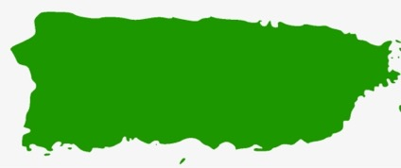
TROPICAL FORESTS
Forest Cover Change
++++
Forest loss globally
Active proceses
Active conservation practices
Forest cover GAIN
Passive processes
Land abandonment
Natural Forest regeneration
Habitat
To what extent these forests are able to recover?
Puerto Rico
Canopy cover
species diversity
Species composition
Species abbundance
Genetic diversity
Agricultural land abbandonment
SDMs
Forets cover 6% → 60%
how habitat availability changed in form 1950 to 2000 for the most common and wide spread tree species (~200 tree species)
which species of which habitat were most effected by the changes in habitat availability?
which species showed the highest habitat increase?
were there any species showed habitat losses? what wa was the entity of the habitat loss?
Forest cover maps
How habitat availability changed over time for tropical trees in PR ?

